Slide 1


Group P11, Speaker - Amit
CSC 522 Project Presentation Utilizing the Open Movie Database API and Netflix Data for predicting rating of a movie
Amit Mandliya (amandli)
Jay Modi (jmodi3)
Jaydip Gabani (jgabani)
Maharshi Parekh (mgparekh)

Slide 2
Group P11, Speaker - Amit
Introduction & Related Work
The idea of the project is to predicts how will a movie perform in IMDB ratings.
The system can be used to make changes to the movies such that it appeals maximum users. The rating prediction system can also be used by the distributors and sellers to identify the sales for a particular movie. Hence, this can improve the overall performance of a movie.
We have also been able to come up with some interesting patterns including movie genres, actors, directors, etc.
Novelty of the model: - Collect a novel dataset - Using dataset to explore a meaningful hypothesis - Implementing a complex machine learning technique

Slide 3
Group P11, Speaker - Amit
Introduction & Related Work
Mladen Miksa Sinisa Pribil Mladen Marovic, Marko Mihokovi c and Alan Tus. 2011. Automatic movie ratings prediction using machine learning. IEEE 54, 2 (May 2011), 1640–1645.
The paper discuss on how the KNN algorithm can be useful in predicting the ratings of a movie. They have used cosine similarities for distancing between users. We have developed a similar model for our baseline. We have used Jaccard distances since many attributes are in sets and different sets can have some common members.
Sarath Babu PB Lijiya A Nithin VR, Pranav M. 2014. Predicting Movie Success Based on IMDB Data. International Journal of Data Mining Techniques and Applications 3 (June 2014).
It uses different models namely - Linear Regression Model, Support Vector Machine Regression Model and Logistic regression. It takes various nominal attributes like Actors, Director,Writer, etc.
Guanghui Wang Lidong Wang and Cheryl Ann Alexander. 2015. Big Data and Visualization: Methods, Challenges and Technology Progress.Digital Technologies 1, 1 (2015)
This paper was useful in improving our visualization methods.

Slide 4
Group P11, Speaker - Jaydip
Method: Dataset
Source : OMDB Dataset - http://www.omdbapi.com/
Format : JSON parsed to csv
Attributes : Numerous, key attributes include: Genre, Director, Actor, Ratings and Votes.
Feature Extraction:
Majority of data either categorical or comma separated string values per attribute.
Selecting features based on insights from Baseline model analysis, Tableau and estimated association rules.
Dataset features plotted using Tableau.
Dataset pivoting and minimisation using pandas library.
Dataset Facts:
Dataset can even have over 10,000 columns based on attributes chosen and pivoted.
Dataset size can exceed over 1.5GB.
Note:Training time and results depends on the size of the training dataset.
Thus, it is crucial to choose right attributes to train our model for good results!

Slide 5
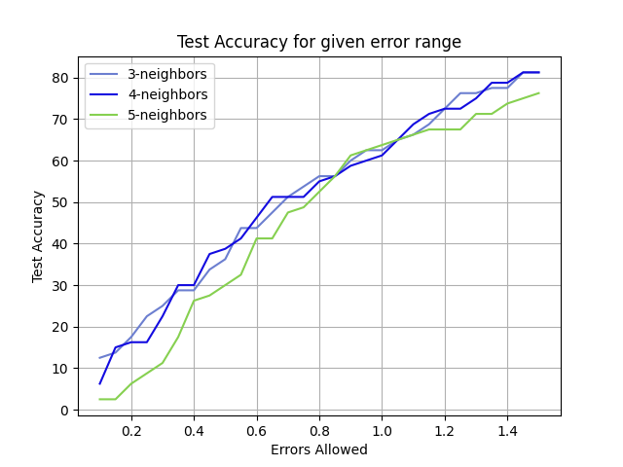
Group P11, Speaker - Jaydip
Method: Baseline Model
Baseline Model: simple yet fares well when the attributes are numerous - KNN Regressor.
Motivation: KNN is very simple, implements ‘feature similarity’ to classify new points.
However, KNN Regressor results show an accuracy of less than 60%. We have aimed to provide a better model than a simple KNN Regressor.

Slide 6
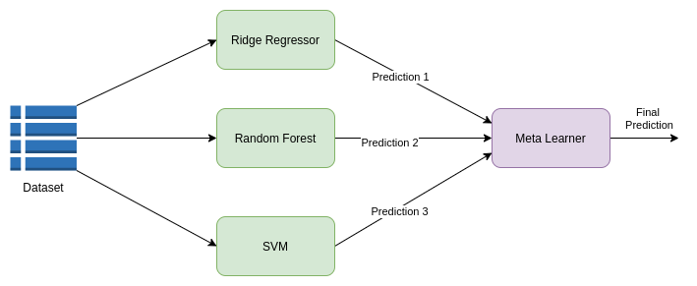
Group P11, Speaker - Jaydip
Method: The Overview
Chosen Model: We use a Stacking Regressor model to create an ensemble regression classifier, underlying models include:
Ridge Regressor - independent accuracy -
Motivation: A good prediction model; helps when some variables might be independent of each other.
Random Forest Regressor - independent accuracy -
Motivation: great for both classification and regression; disallows overfitting trees in model
Support Vector Machines - independent accuracy -
Motivation: acclaimed model when there exists non-linear relationships between features

Slide 7
Group P11, Speaker - Jaydip
Method: Details
Dataset Split: Test and Train data was split 80:20 Test:Train with our dataset having around 4000 rows, with attributes being chosen among Ratings, Genre, Actors, Writers, Directors, Language, Country and Production.
Model Structure: Selecting 3 models based on their usefulness, in our case, Ridge Regressor, Random Forest and SVM. Next, we process their predictions using sklearn’s Stacking regressor which learns based on the results of the other regressors.
Alternative: We didn’t choose Voting regressor since it will work best when all the regressors are working equally well. We also didn’t choose Lasso regression, since the dimensionality was too high to be provide good results.
Evaluation Methods:
Training and Testing errors
Accuracy over error margin: Given an error margin, how well can our model predict the Movie rating?
R² score
Relationships extracted between Features from our current model.

Slide 8

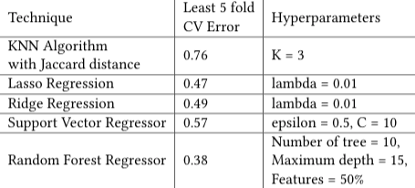
Group P11, Speaker - Maharshi
Results
Initial Tuning and Results:
KNN with Jaccard Distance provided us with a CV error of 0.76
The best and promising model after choosing our baseline is the Random Forest Generator - with 50% features being used to predict ratings.
3. Our chosen models had lesser error and have been hyperparameter tuned based on tuning.py script.
4. Expectations are to realise a much better prediction model than our baseline.

Slide 9
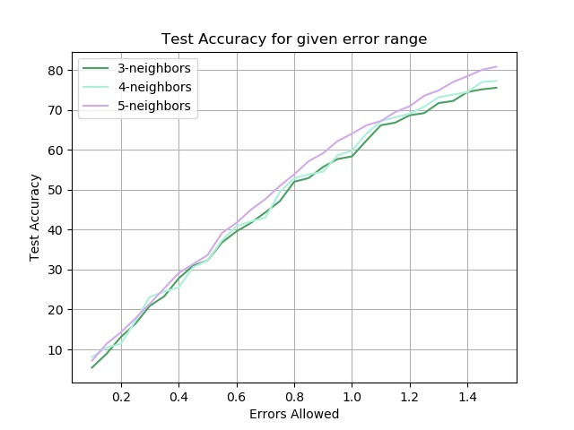
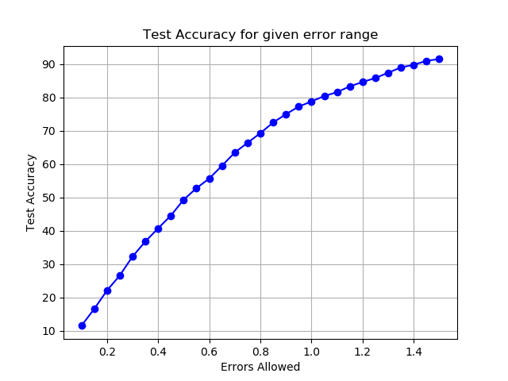
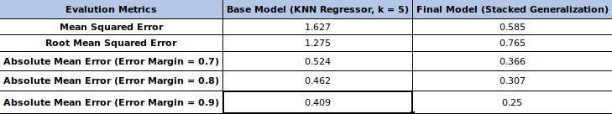
Group P11, Speaker - Maharshi
Results
As you can see from the charts - tuning the hyperparameters of each of the ridge, Random Forest and SVM provide for a fine and better accuracy yielding predictor.
The MSE and RMSE have improved significantly in our model from the baseline.
It is important to note that the error margin provides room for better estimation.
Baseline KNN Regressor
Stacked Generalized Model

Slide 10
Group P11, Speaker - Jay
Discussion: What do your results mean? Why do they matter?
Combing the data with a fine tooth, and over hundreds of columns of attributes we learn:
Computations are time-intensive if improper attributes are chosen
Accuracy / Error did not increase/decrease by any significant amount while trying to find associations between Actors and Directors {Tweaking Lasso Regression’s alpha value was not effective in finding results}.
Given a good estimate of error margin, our Stacked Regressor model is effective in predicting the rating of a movie, given its Title, Genre, Actors, Writers, and Language.
An unexpected association between Genre, Movie Runtime and Production House - the model fared much better if these attributes were given more weights!
We can now successfully predict a Movie’s Rating out of 10 with 80% accuracy!
Our model is especially useful when you would like to predict the rating of a Movie when you have a lot of details about the movie.

Slide 11
Group P11, Speaker - Jay
Discussion: What can your results teach us about your problem?
Complexity & Dataset- Given the dimensionality and the diversity in each attribute, finding correlations between attributes and finding the major contributing factor is difficult. Complexity increases as you analyze deeper and the most important factor is the dataset being used.
Dataset and Attributes Matter to predict Ratings: Surprising association was found between Genre, Production Company and Movie Runtime - our model fared much well with an accuracy reaching 76% with error margin of 0.8.
Missing factors: Just like there can be several hidden nodes in Bayesian Network, there might be another important factor in a Movie Prediction system, speculated to be the story of the movie. Advanced NLP analysis on the storyline might provide unexpected insights and results.
Regression models: Both our reports highlight the results obtained from each model we experimented with. As expected Stacked Regression works well with many weak models and provides a result with strong confidence. Various alternative approaches have also been discussed in the reports.
Data Analysis: Our project also shows that data analysis is about the right model selection, correct data preprocessing and the results can sometimes be surprising!

Slide 12
Group P11, Speaker - Jay
Thank You

